Slide 1

Federation Profile
STONGER TOGETHER IN TOURISM

Slide 2
Content
About the Federation
Our Story
Mission
Vision
Objective
Strategies and Plans
Action plans
Target groups
Our people
Executive Team
Secretariat Team
Membership
Our members
How to become our member?

Slide 3

About Federation
Our Story
Mission
Vision
Objective

Slide 4

Our Story
FOUNDERS
1- Pacific Asia Travel Association Cambodia
Chapter (PATACC)
2- Cambodia Hotel Association (CHA)
3- Cambodia Restaurant Association (CRA)
4- Cambodia Airport (SCA)

Slide 5
Our Story
FUNDERS:
1- Cambodia Airport (SCA)
2- Thalias Group
3- All tourism stakeholders (hotels, restaurants, etc..)
SPONSORS:
1- SMART
2- BRED BANK
3- KHMER BEVERAGES

Slide 6
Mission
The mission of the Cambodia Tourism Federation (CTF) is to unite the private- sector and their associations represent the diverse interests of Cambodia's tourism industry, fostering collaboration and innovation to promote sustainable growth, enhance the quality of services, and elevate Cambodia as a premier global travel destination.

Slide 7
Vision
The vision of the Cambodia Tourism Federation (CTF) is to establish Cambodia as a world-renowned tourism destination known for its rich cultural heritage, vibrant modern experiences, exceptional hospitality, and commitment to sustainable tourism development.

Slide 8

Objectives
Advocacy and Policy Support
Enhance Tourism Infrastructure and Services
Promote Sustainable Tourism Practices
Strengthen Marketing and Promotion
Capacity Building and Training
Foster Collaboration and Innovation

Slide 9
Strategies and Action Plans
Strategy
Action
Target groups

Slide 10
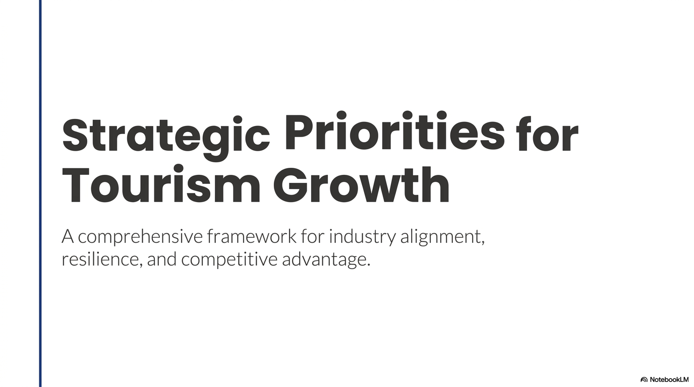

Slide 11
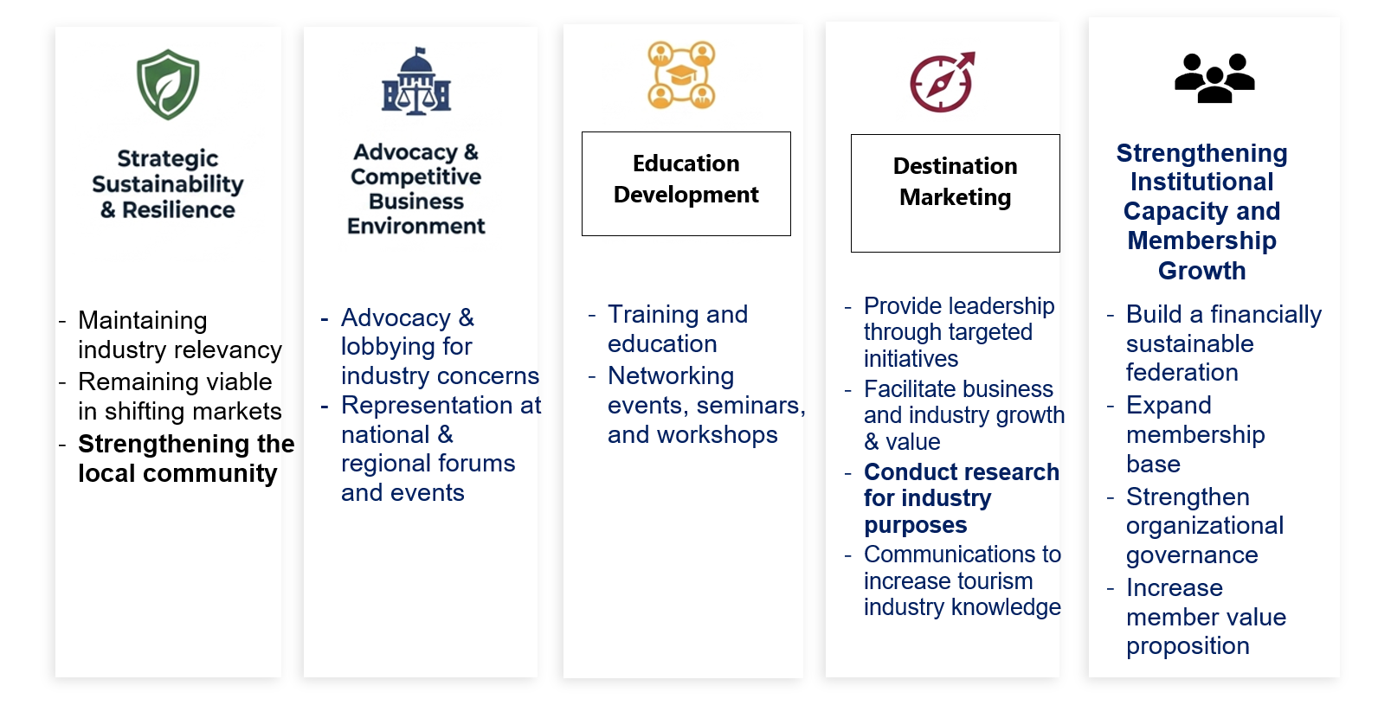
Strategy Plan
Present the 5 pillars CTF Strategy
Advocacy
Education Development
Destination
Marketing
Membership Growth
Sustainability and Resilience
Membership Growth

Slide 12

Target groups
Tourism Associations:
Cambodia Hotel Association
Cambodia Restaurant Association
Cambodia Chef Society
Pacific Asia Travel Association in Cambodia (PATACC)
CAMDMC (Cambodia Destination Management Company)
Cambodia Spa and Wellness Association
Cambodia Airport
Siem Reap Tourism Club (STC)
Professional Institute of Excellence (PIE)
Cambodia Association of Travel Agents
EuroCham – Tourism Hospitality Committee
Phnom Penh Tour Guide Association
Siem Reap Tour Guide Association
Notes:
Member’s category
Full Member
Associated member
Ordinary member
Sponsors

Slide 13
Target groups
Business Associations:
International Business of Cambodia (IBC)
Business Chamber of Commerce
Industrial Association

Slide 14
Target groups
Local Communities:
Communities/ Community Ecotourism
Non-Government Organization (NGO’s)
Artisans and local businesses

Slide 15
Our People
Executive Committee
Secretariat Team
Notes:
CAM-DMC Committee member

Slide 16
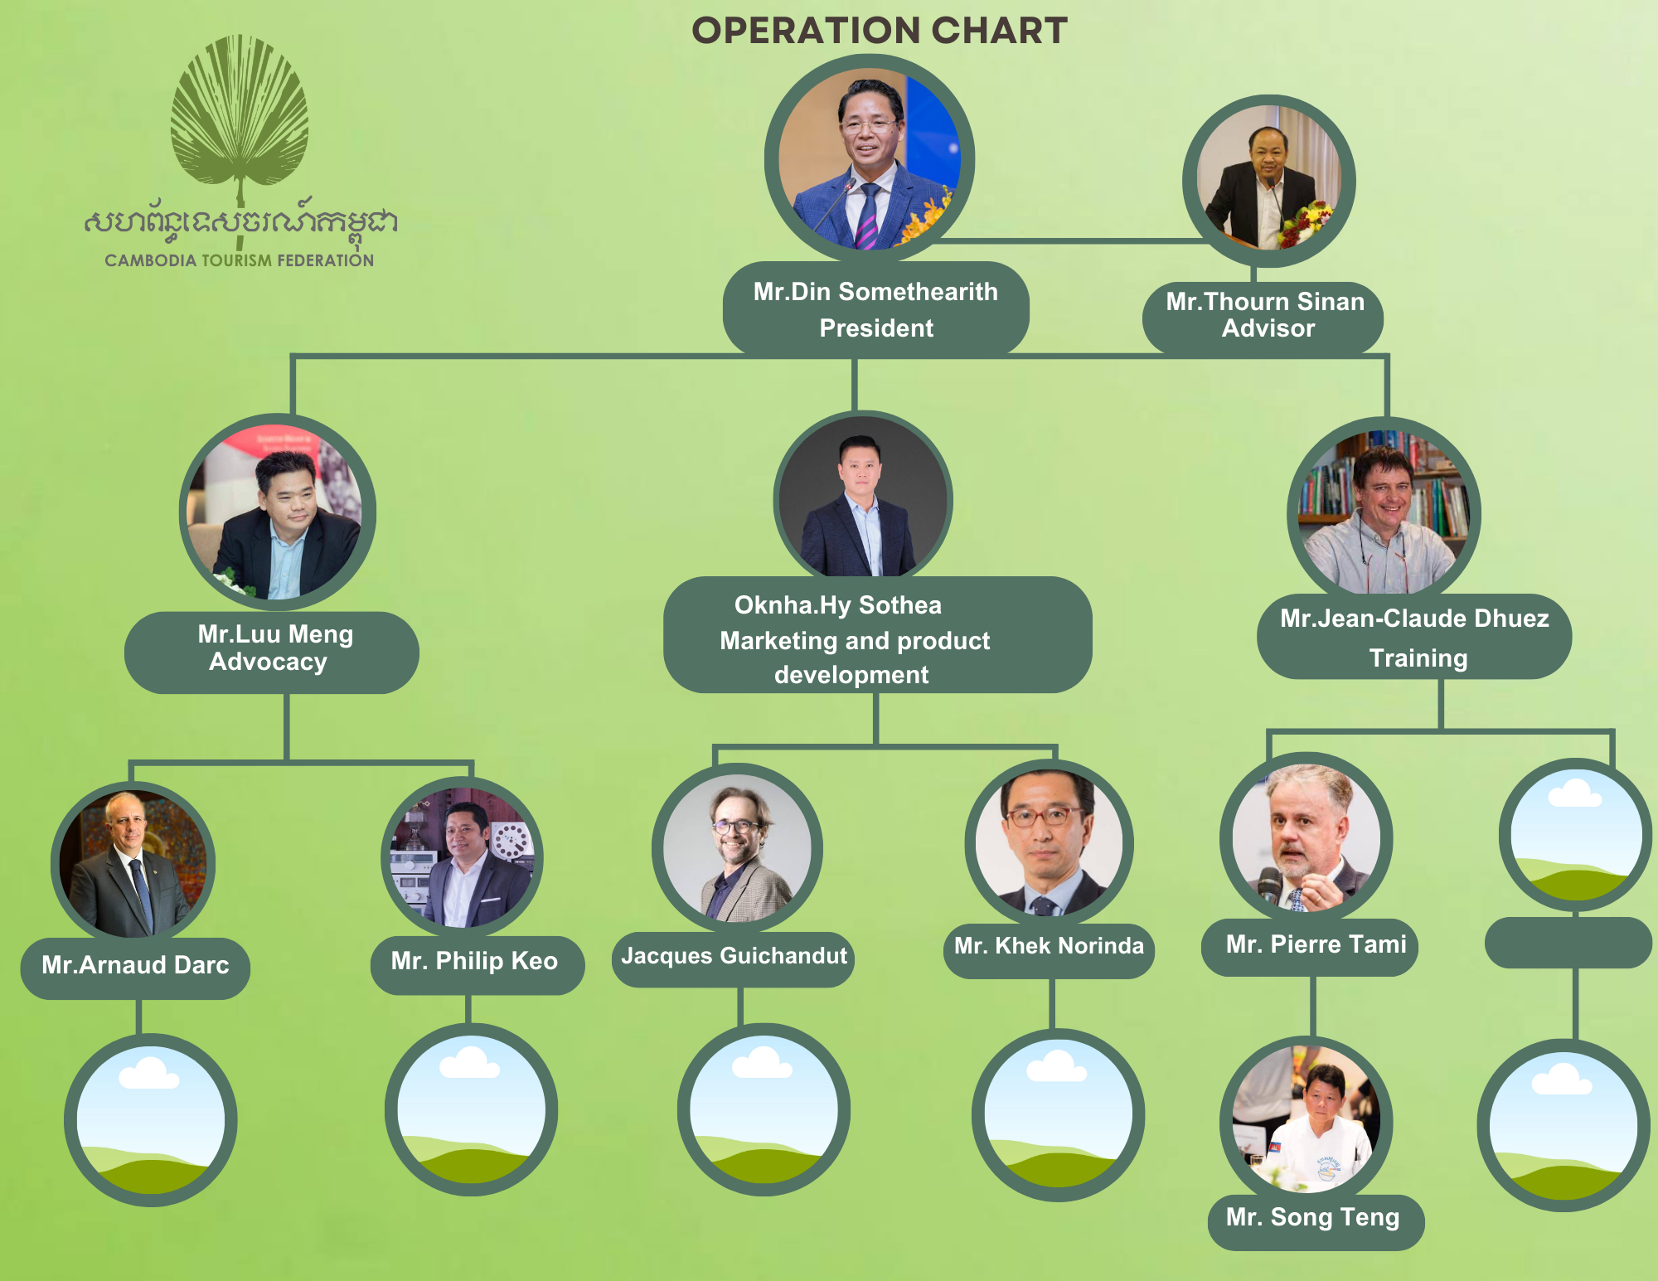
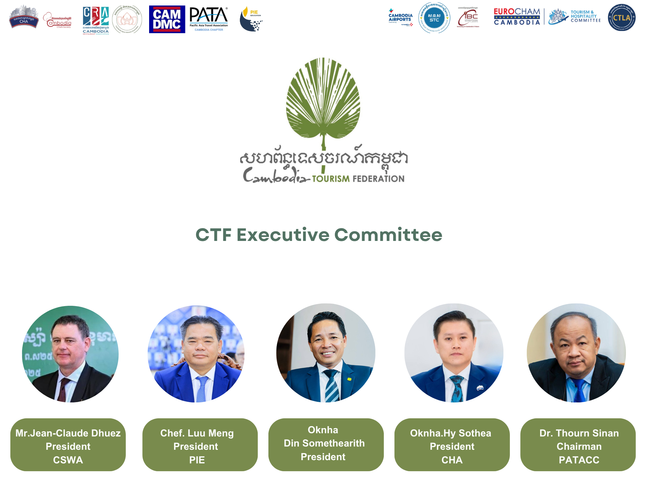
Notes:
Logo CTF small
Logo association bigger
Title each other = CTF Ex-Com

Slide 17
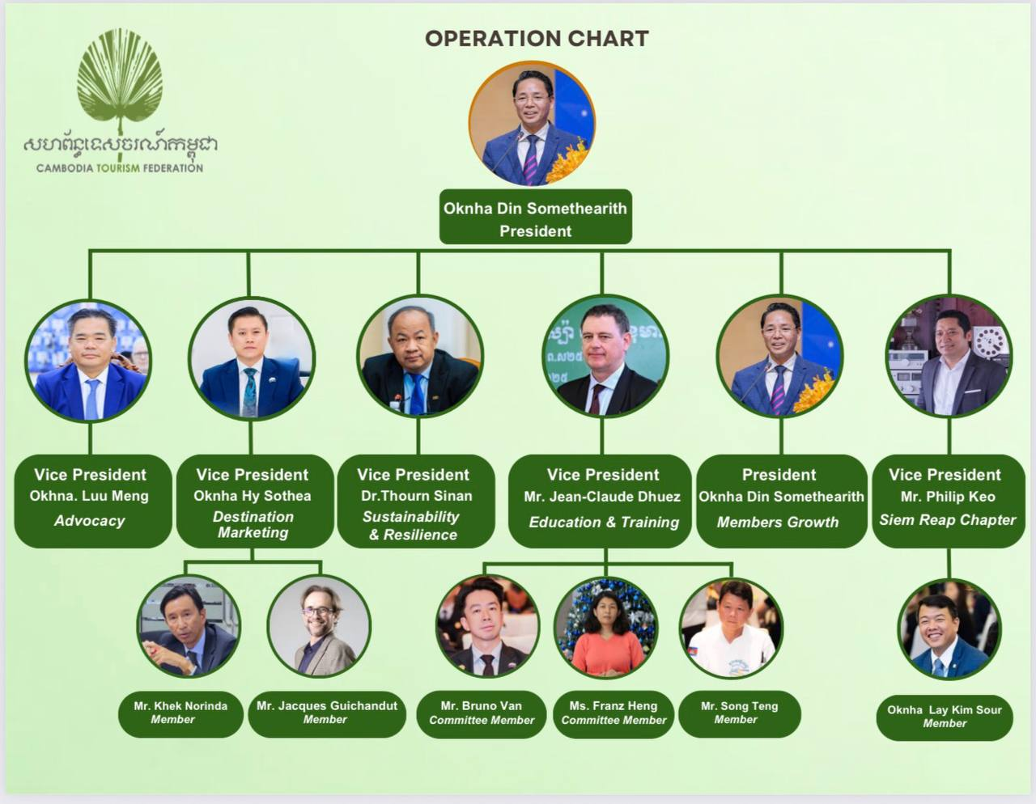

Slide 18

Secretariat team
Executive Director
Manager
Admin and accountant
Event supportive staff
Intern

Slide 19

Members
Our Member
How to become our member

Slide 20

Members
Tourism Associations:
Cambodia Hotel Association
Cambodia Restaurant Association
Cambodia Chef Society
Pacific Asia Travel Association in Cambodia (PATACC)
CAMDMC (Cambodia Destination Management Company)
Professional Institute of Excellence (PIE)
Siem Reap Tourism Club (STC)
EuroCham – Tourism Hospitality Committee
Cambodia Spa and Wellness Association
Cambodia Airport
International Business Chamber of Cambodia (IBC)
Cambodia Logistic and Transportation association (CLTA)

Slide 21
How to become our Members
If you are either:
Tourism Association
Business Association
Chamber of Commerce/Tourism
Local Community/Community Based Ecotourism
Non-Government Organization (NGO)/Tourism
Notes:
Cooperated company
Chamber of Commerce/Tourism
NGO’s (Tourism)
Ordinary member = CBET

Slide 22
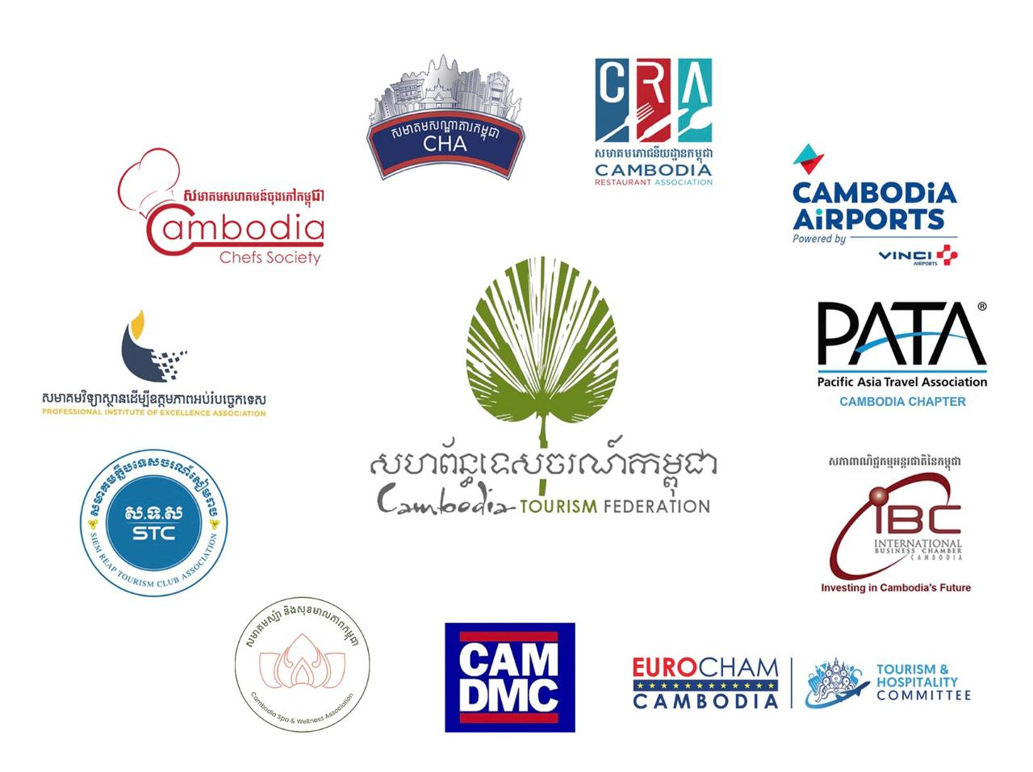
New 2027 Initiatives
What are your keys plans for the coming year?
One
Two
Three

Slide 23
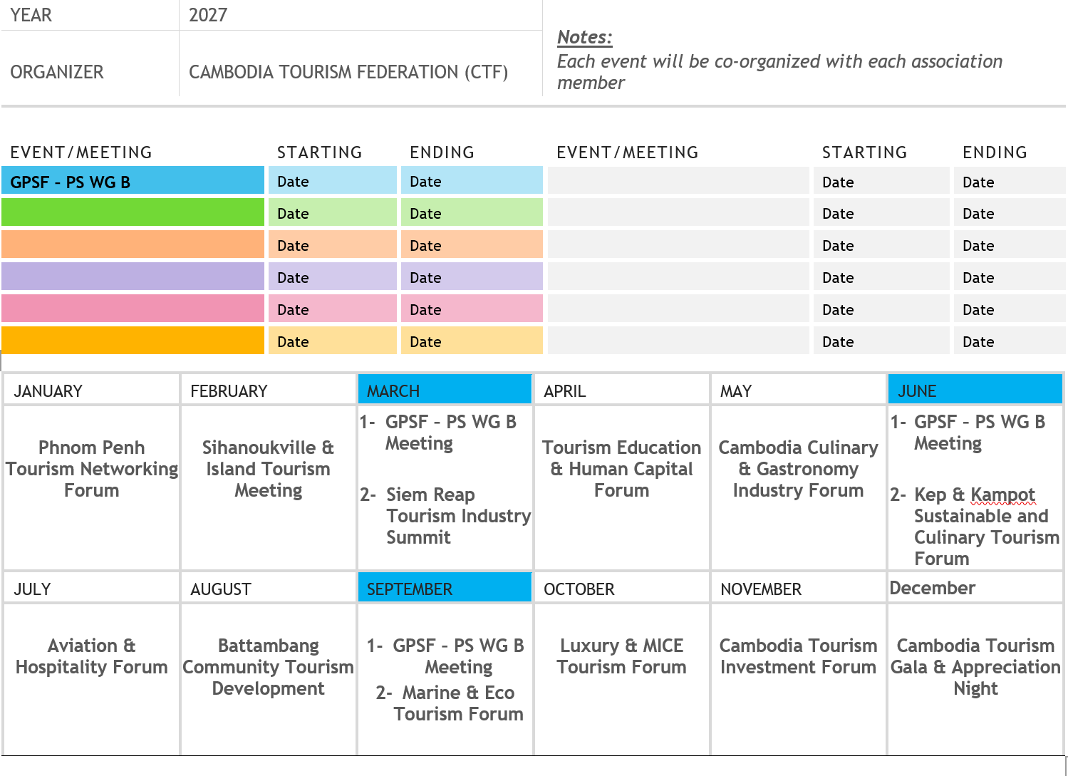

Slide 24
Thank you
Notes:
Research – Data
CDRI => Target tourism

